Slide 1
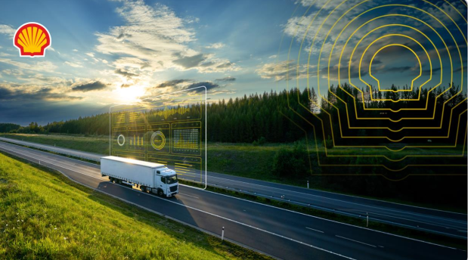
Shell.Ai Sustainable
and Affordable Energy

Slide 2
TITLE
Title: Fleet Decarbonization Optimization
Subtitle: Shell.ai Hackathon 2024
Name: Mathew Mwangi
Date: 31/06/2024

Slide 3
Concept Overview
My concept leverages advanced mathematical optimization models to transition fleets to net-zero emissions cost-effectively. By integrating vehicle data, fuel consumption metrics, and carbon emission constraints, our solution minimizes the total cost of ownership while meeting stringent emission targets. This approach surpasses existing technologies by offering a holistic, data-driven method for fleet management, ensuring both sustainability and operational efficiency.

Slide 4
Concept Development
The concept was developed by analyzing the provided data on vehicle specifications, fuel consumption, and carbon emissions. I identified the need for a balanced approach that minimizes costs and adheres to emission limits. The core idea was to create a model that optimizes vehicle purchases, usage, and resale over time, ensuring demand satisfaction and compliance with carbon emission targets.

Slide 5
Algorithms Used
The primary algorithm used is linear programming, implemented using the PuLP library. Linear programming is ideal for this problem as it efficiently handles constraints and optimizes a linear objective function. My model considers multiple decision variables and constraints to achieve the optimal fleet composition and usage strategy.

Slide 6
Algorithm Selection
I chose linear programming due to its robustness in handling complex optimization problems with multiple constraints. Compared to other algorithms like genetic algorithms or simulated annealing, linear programming provides exact solutions and ensures all constraints are strictly adhered to, making it the best fit for our problem.

Slide 7
Impact of Chosen Algorithm
The use of linear programming significantly impacted My concept by enabling precise optimization of fleet operations. It allowed us to systematically incorporate various cost factors and constraints, leading to a well-balanced solution that minimizes total costs while meeting all demands and emission targets.

Slide 8
Proposed Architecture
My architecture consists of data preprocessing, optimization model formulation, and result extraction. Data preprocessing involves loading and cleaning the datasets. The optimization model is formulated using PuLP, defining decision variables, objective function, and constraints. Finally, results are extracted and saved to CSV for further analysis and reporting.

Slide 9
Development Factors
Cost Minimization: Purchase, insurance, maintenance, and fuel costs.
Emission Compliance: Adhering to yearly carbon emission limits.
Demand Satisfaction: Ensuring fleet meets yearly distance demands.
Vehicle Lifespan: Managing vehicle purchases and resale over time.
Fuel Compatibility: Matching vehicles with compatible fuel types

Slide 10
Competitive Landscape
Using a matrix, I compared the concept with existing fleet management solutions. My approach stands out due to its comprehensive optimization model, integrating cost and emission factors, which is not typically addressed in conventional fleet management systems.

Slide 11
Comparison with Alternatives
My concept offers a unique combination of cost optimization and emission compliance. Unlike traditional fleet management solutions that focus primarily on operational efficiency, my model integrates environmental sustainability as a core component, providing a dual benefit of cost savings and reduced carbon footprint.

Slide 12
Intellectual Property Landscape
Currently, there are patents on specific algorithms and systems for fleet management and optimization. However, my unique integration of linear programming for simultaneous cost and emission optimization, tailored to fleet decarbonization, presents a novel approach that could be considered for patent protection

Slide 13
Competitors
Current Competitors:
Conventional Fleet Management Systems (e.g., Fleet Complete, Samsara)
Environmental Optimization Software (e.g., Optoro, Locus)
Future Competitors:
Emerging AI-driven Fleet Management Solutions
Sustainability-focused Tech Startups

Slide 14
Market Size
Total Addressable Market (TAM): The global fleet management market, valued at approximately $19 billion.
Serviceable Addressable Market (SAM): The market segment focusing on fleet decarbonization, estimated at $5 billion.
Serviceable Obtainable Market (SOM): The realistic portion of the market we can capture, projected at $1 billion.

Slide 15
Market Size Calculation
I Calculated the market size using industry reports and market research data. The TAM was derived from the total global fleet management market value. The SAM was estimated based on the proportion of the market interested in sustainability and decarbonization. The SOM was calculated considering our competitive positioning and potential market share.

Slide 16
Conclusion
My innovative approach to fleet decarbonization combines cost efficiency and environmental responsibility. By leveraging advanced optimization algorithms and comprehensive data analysis,I offer a solution that not only meets but exceeds current industry standards, paving the way for a sustainable future in fleet management.

Slide 17
Thank you
Thank you for your attention. I welcome any questions or feedback on my presentation and concept.

